Slide 1

Deep Learning-Based
Multi-User Detection for
Underwater Optical NOMA
Communication Systems
NATIONAL INSTITUTE OF TECHNOLOGY
HAMIRPUR
Using 1D-CNN Architecture
Dept. of Electronics & Communication Engineering
Group Members:
Akashdeep Saini (23BEC005)
Anshul Sharma (23BEC015)
Ashish Rajpal (23BEC024)
Ashish Singh (23BEC025)
Avinash (23BEC026)
Avirat Mahajan (23BEC027)
Ayush Ghosh (23BEC028)

Slide 2
Table of Contents
01
Abstract
06
CNN Architecture
02
Introduction & Motivation
07
Results & Discussion
03
Literature Review
08
Comparative Analysis
04
System Description & Methodology
09
Conclusion & Future Work
05
Channel Model
UWOC NOMA | NIT Hamirpur
2 / 18

Slide 3
Abstract
⚡
🧠
📈
Problem
Approach
Result
SIC receiver fails in turbulent underwater optical channels due to error propagation
1D-CNN joint decoder trained on 150,000-sample MATLAB synthetic dataset
67% range extension (15m→25m); 28.56 dB BER gain for User 1 in pure sea water
UWOC NOMA | NIT Hamirpur
3 / 18

Slide 4
Introduction & Motivation
WHY UWOC?
SIC LIMITATIONS
Ocean covers >70% of Earth's surface
Acoustic comms: limited to few kHz; 1.5s/km delay
UWOC: 100 Mbps–Gbps over tens of metres
Blue-green wavelengths (450–550 nm) minimal absorption
AUVs, ROVs, sensor networks need high-BW links
Requires accurate CSI — rarely available underwater
Error propagation: Stage 1 failure cascades to all users
Saturates at BER ≈ 0.50 under high turbidity
Sequential decoder ill-suited for joint multi-user signals
Performance collapses before theoretical limit
UWOC NOMA | NIT Hamirpur
4 / 18

Slide 5
Literature Review
[1] Salama et al.
CNN-LSTM UWOC-NOMA; 6% sum-rate gain over OMA; GOPA 1.2–8.7% improvement.
Opt. Quant. Electron. (Springer 2023)
[2] Panda & Singh
ConvNet-LSTM for RF NOMA; ~15% BER gain (U2); no optical channel.
AEU-Int. J. Electron. (Elsevier 2023)
[3] Li et al.
Real-time UWOC-NOMA hardware; SIC degrades under turbidity; no DL receiver.
J. Lightwave Tech. (IEEE 2024)
[4] Liang et al.
Closed-form BER for SIC in Gamma-Gamma turbulence; BER floor proven analytically.
Opt. Commun. (Elsevier 2023)
UWOC NOMA | NIT Hamirpur
5 / 18

Slide 6
System Description & Methodology
Binary
Bit Sequences
User 1 & 2
BPSK
Modulation
NOMA Power
Superposition
P1=0.8, P2=0.2
Underwater
Optical Channel
(Beer-Lambert
+ Turbulence)
SIC / 1D-CNN
Decoder
BER
Evaluation
Key Parameters
Modulation:
BPSK
Water Types:
Pure Sea / Clear Ocean / Coastal
Power Split:
P1=0.8, P2=0.2 (ratio 4:1)
Dataset Size:
150,000 samples
Link Distances:
1–30 m (15 points, step 2 m)
Evaluation Points:
45 BER points per decoder
UWOC NOMA | NIT Hamirpur
6 / 18

Slide 7
Underwater Optical Channel Model
Beer-Lambert Attenuation: h_BL = exp(−c·d)
Water Type | c (m⁻¹) | h_BL @ 15m | h_BL @ 25m
Pure Sea Water | 0.056 | 0.432 | 0.247
Clear Ocean Water | 0.150 | 0.105 | 0.023
Coastal Water | 0.398 | 0.0023 | 0.000046
Lognormal Turbulence: h_turb = exp(2X), X ~ N(−σ²/2, σ²)
Water Type | σ_l | E[h²] = exp(4σ²) | SNR_eff @ d=25m (dB)
Pure Sea Water | 0.1 | 1.041 | −5.21 dB
Clear Ocean Water | 0.2 | 1.174 | −22.14 dB
Coastal Water | 0.4 | 1.896 | −56.73 dB
Received signal: y = h_BL · h_turb · x_tx + n, n ~ N(0, 0.02)
UWOC NOMA | NIT Hamirpur
7 / 18

Slide 8
Proposed 1D-CNN Receiver Architecture
Layer | Type | Parameters | Output Shape
Input | imageInputLayer | seq_len=8 | [8×1×1]
Conv Block 1 | Conv2D [3×1], 16 filters | BN + ReLU | [8×1×16]
Conv Block 2 | Conv2D [3×1], 32 filters | BN + ReLU | [8×1×32]
Conv Block 3 | Conv2D [3×1], 64 filters | BN + ReLU | [8×1×64]
Pooling | Global Avg Pooling 2D | Collapses temporal dim | [64]
FC1 | Fully Connected | 64 neurons, ReLU | [64]
Dropout | Dropout | Rate = 0.30 | [64]
FC Out | Fully Connected | 2 neurons | [2]
Output | Regression Layer | MSE loss | [2]
Training Hyperparameters
Optimiser:
Adam
Learning Rate:
1×10⁻³ (halved / 10 ep)
Batch Size:
512
Epochs:
30
Dropout:
0.30
Loss:
MSE (regression)
Split:
70 / 15 / 15 %
UWOC NOMA | NIT Hamirpur
8 / 18

Slide 9
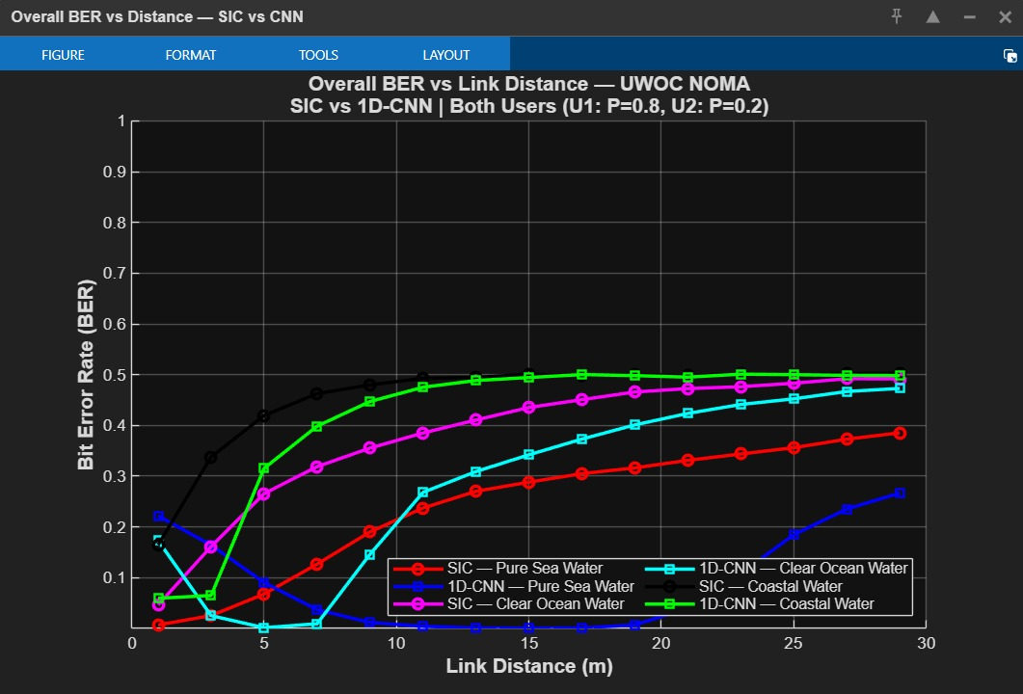
Results: Overall BER vs. Link Distance
Fig. 1 — SIC (dashed) vs. 1D-CNN (solid) across Pure Sea, Clear Ocean & Coastal Water
UWOC NOMA | NIT Hamirpur
9 / 18

Slide 10
Key Observations: BER Performance
Pure Sea Water (c = 0.056 m⁻¹)
CNN BER ≈ 0 across entire 1–30 m range
SIC BER rises past 15 m → reaches 0.39 at 29 m
Reliable range extended by 67%: CNN @ 25 m vs SIC @ 15 m
Clear Ocean Water (c = 0.150 m⁻¹)
Both decoders degrade with distance
CNN consistently tracks below SIC throughout range
CNN advantage visible at all distances
Coastal Water (c = 0.398 m⁻¹)
Both decoders saturate near BER = 0.50 beyond ~7 m
h_BL = 0.000046 at 25 m — catastrophic Beer-Lambert loss
CNN converges to saturation more slowly; lower BER floor
UWOC NOMA | NIT Hamirpur
10 / 18

Slide 11
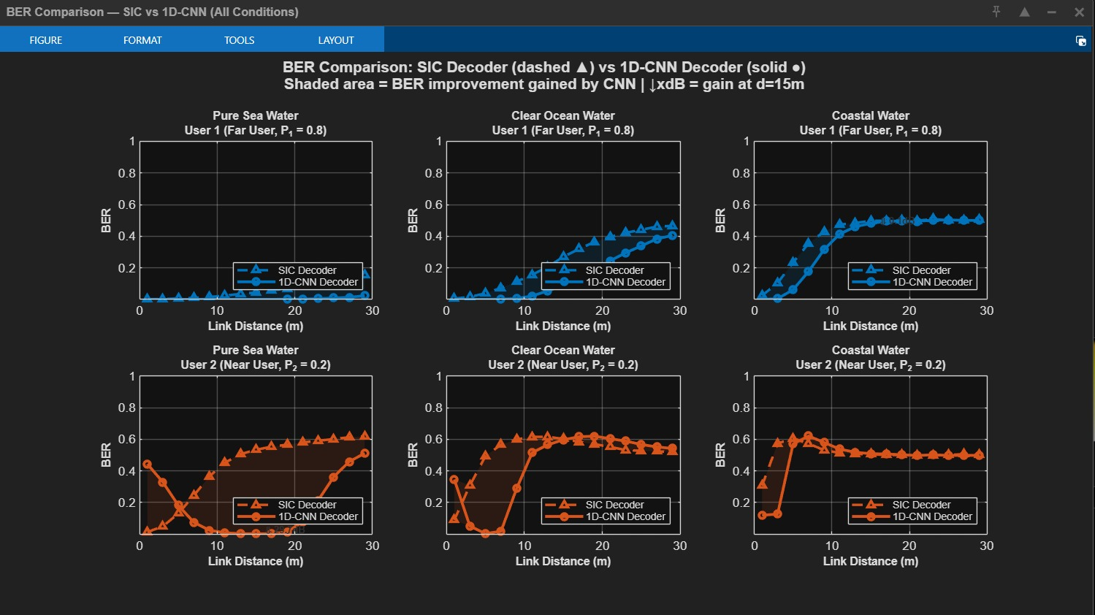
Per-User BER Analysis
Fig. 3 — 1D-CNN (solid) vs. SIC (dashed) for User 1 (blue, far user P1=0.8) and User 2 (orange, near user P2=0.2)
User 1: CNN dramatically outperforms SIC. User 2: SIC briefly outperforms CNN at very short distances; CNN takes over beyond ~7 m.
UWOC NOMA | NIT Hamirpur
11 / 18

Slide 12
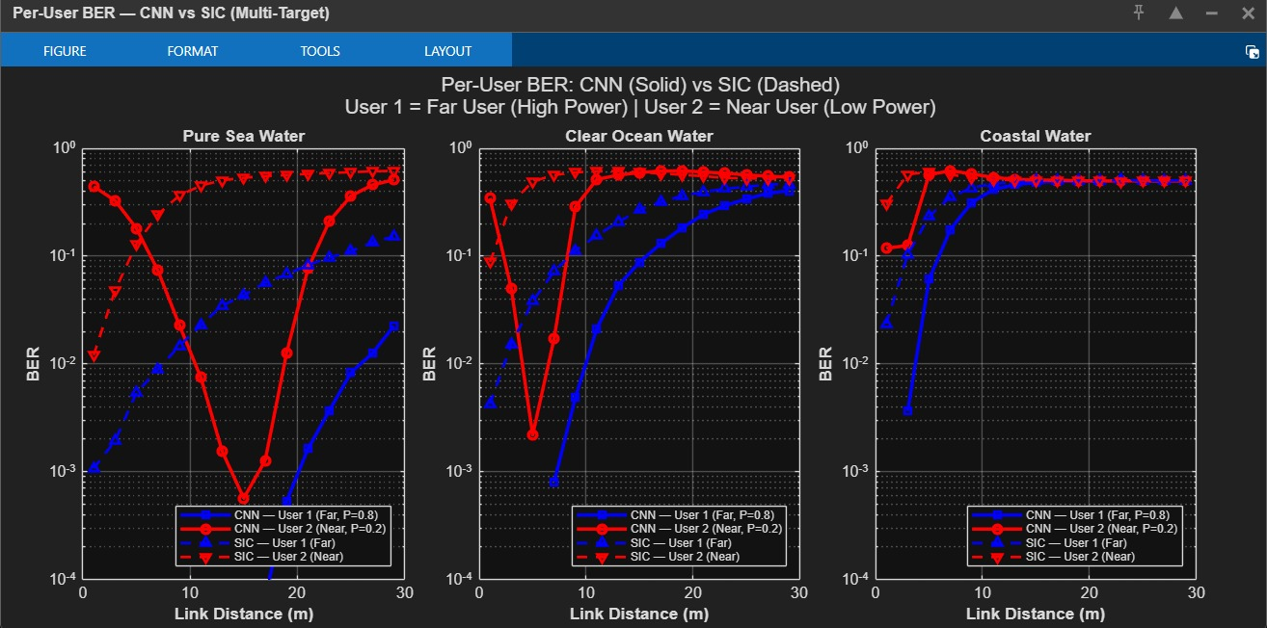
Log-Scale BER — Error Floor Analysis
Fig. 4 — V-shape for CNN User 2 in pure sea water: BER drops to ~10⁻³ at 7–12 m due to temporal diversity, then rises as attenuation dominates.
SIC User 2 BER never drops below ~10⁻². CNN User 2 BER reaches 10⁻³–10⁻⁴ in optimal distance regime — demonstrates error-propagation immunity.
UWOC NOMA | NIT Hamirpur
12 / 18

Slide 13
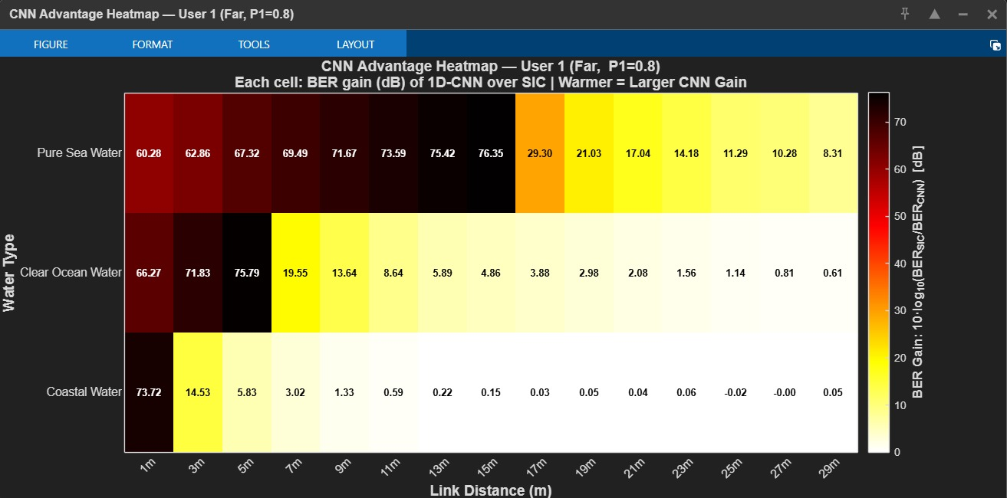
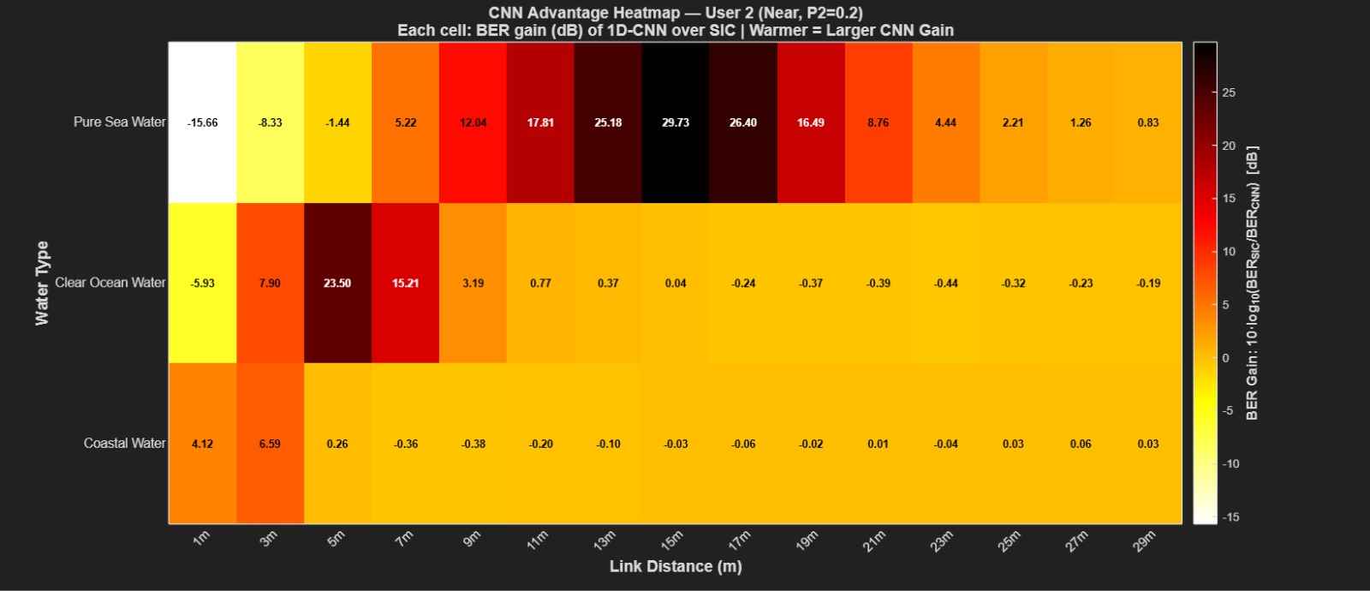
CNN BER Gain Heatmaps
Fig. 5 — User 1 CNN Advantage (dB). Warm = large CNN gain. Gains >60 dB at 1–15 m in pure sea water.
Fig. 6 — User 2 CNN Advantage (dB). White/cool = SIC outperforms CNN at short distances. Peak gain: 29.73 dB at 13–17 m.
CNN advantage primarily from eliminating Stage 1 decoding errors — which in SIC cascade to User 2 (error propagation).
User 1 Max Gain
User 2 Peak Gain
Coastal U1 Gain
>60 dB
pure sea 1–15 m
29.73 dB
pure sea 13–17 m
4.64 dB
both saturate
UWOC NOMA | NIT Hamirpur
13 / 18

Slide 14
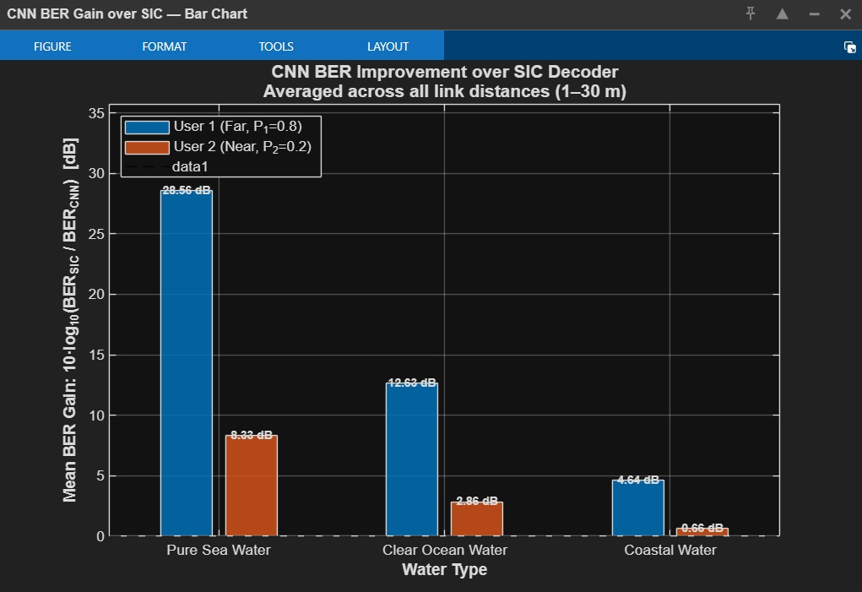
Mean BER Gain Summary
Table V — Mean CNN BER Gain (dB)
Water Type | U1 (dB) | U2 (dB)
Pure Sea Water | 28.56 | 8.33
Clear Ocean Water | 12.63 | 2.86
Coastal Water | 4.64 | 0.66
Key Insights:
CNN advantage decreases monotonically as turbidity increases
Large User 1 advantage confirms CNN eliminates Stage 1 errors
Even in coastal water CNN is marginally better (4.64 dB U1)
CNN does not require channel state information at any stage
Fig. 7 — Bar chart of mean BER gain (dB) averaged across 1–30 m for both users and all three water types.
UWOC NOMA | NIT Hamirpur
14 / 18

Slide 15
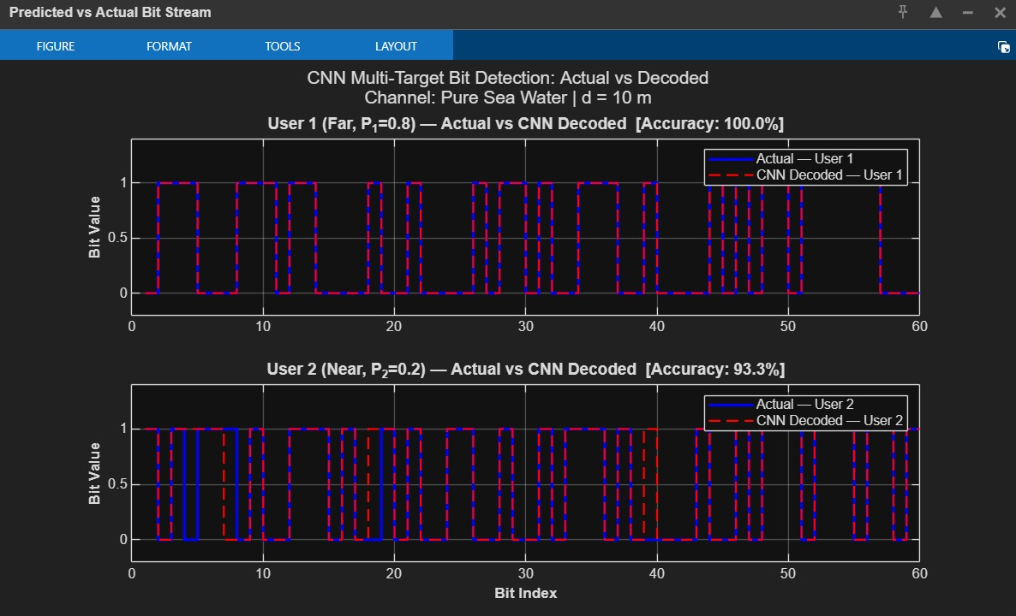
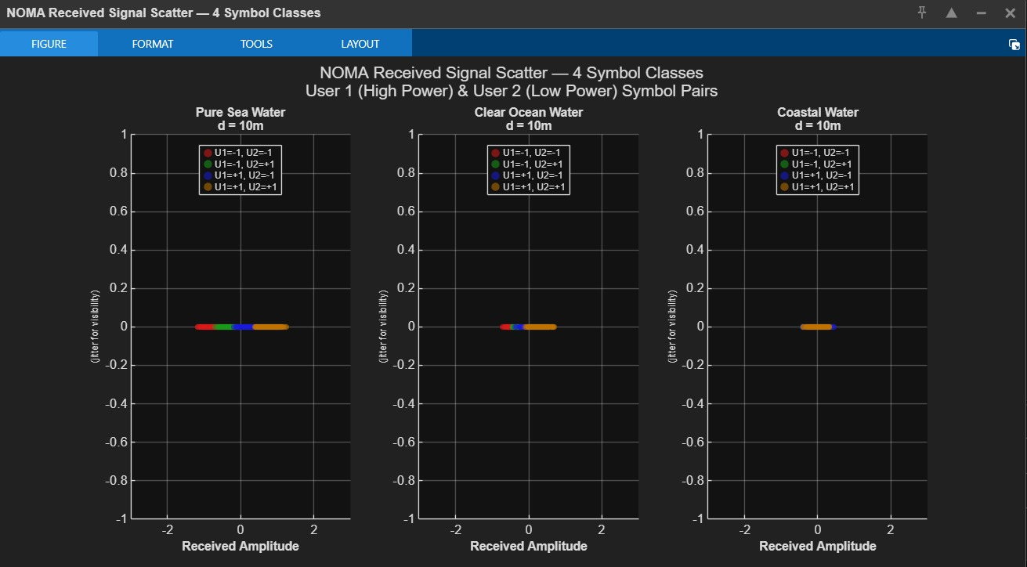
Multi-Target Detection & Signal Scatter Analysis
Fig. 9 — NOMA received signal scatter: 4 BPSK-NOMA symbol classes at d=10 m.
Increasing turbidity overlaps clusters — explaining SIC saturation under coastal water.
Fig. 8 — Actual (blue) vs CNN-decoded (red dashed) bit streams at d=10 m, pure sea water.
User 1: 100% accuracy. User 2: 93.3% accuracy (joint simultaneous decoding).
The CNN's learned soft probabilistic boundary handles cluster overlap where SIC's hard threshold fails.
UWOC NOMA | NIT Hamirpur
15 / 18

Slide 16
Comparative Analysis with Published Work
Reference | Method / Channel | Key Metric | Our Work
Salama et al. [Springer 2023] | CNN-LSTM + NOMA Generic UWOC relay | ~6% sum rate gain over OMA | Our CNN: 28.56 dB avg BER gain over SIC; directly comparable reliability improvement
Panda & Singh [Elsevier 2023] | ConvNet-LSTM RF NOMA channel | ~15% BER gain U2 ~8.6% BER gain U1 | Our CNN: 8.33 dB U2, 28.56 dB U1 under far harsher optical channel (Beer-Lambert + turbulence)
Li et al. [IEEE 2024] | SIC hardware Real UWOC test | SIC degrades under turbidity; no DL receiver | CNN maintains stable BER where SIC saturates; 67% range extension directly demonstrated
Liang et al. [Elsevier 2023] | Analytical SIC Gamma-Gamma turbulence | BER floor proven analytically for SIC | CNN eliminates error propagation, breaking analytically-predicted SIC BER floor
UWOC NOMA | NIT Hamirpur
16 / 18

Slide 17
Conclusion & Future Work
Key Achievements
Future Work
1D-CNN outperforms SIC across all water types and distances
67% range extension: ~15 m (SIC) → ~25 m (CNN) in adverse conditions
Mean BER gains: 28.56 dB / 12.63 dB / 4.64 dB for User 1 (pure sea / clear ocean / coastal)
100% User 1 accuracy, 93.3% User 2 accuracy at d=10 m (joint simultaneous decoding)
Error-propagation immunity: CNN User 2 BER reaches 10⁻³–10⁻⁴; SIC floor ≈ 10⁻²
Extend to 3+ NOMA users
LSTM/GRU or attention mechanisms
Pointing error & beam divergence models
FPGA-based real-time CNN inference
Adaptive power allocation + CNN joint optimisation
Non-stationary turbulence & water tank testbed
Limitations
Simulation only — hardware validation in water tank required
Two users only; CNN not tested for 3+ user scenarios
Fixed noise variance (σ² = 0.02); time-varying noise not evaluated
CNN marginally suboptimal for near user (U2) at very short distances in clean water
UWOC NOMA | NIT Hamirpur
17 / 18

Slide 18
References
[1] W. M. Salama, M. H. Aly, E. S. Amer, "Underwater optical wireless communication system: Deep learning CNN with NOMA-based performance analysis," Optical and Quantum Electronics, vol. 55, no. 436, Springer Nature, Mar. 2023.
[2] B. Panda and P. Singh, "A deep convolutional-LSTM neural network for signal detection of downlink NOMA system," AEU-Int. J. Electronics and Communications, vol. 170, Elsevier, 2023.
[3] X. Li et al., "NOMA Assisted Real-Time Downlink UWOC System Using a Software-Configurable Driver Under Different Channel Conditions," IEEE/Optica J. Lightwave Technology, vol. 42, no. 14, pp. 4860–4873, IEEE, July 2024.
[4] Y. Liang et al., "BER analysis for PAM-based UWOC-NOMA system in oceanic turbulence environment," Optics Communications, vol. 545, Article 129631, Elsevier, Oct. 2023.
[5] Z. Zeng et al., "A Survey of Underwater Optical Wireless Communications," IEEE Communications Surveys & Tutorials, vol. 18, no. 3, pp. 1855–1888, 2016.
[6] H. Kaushal, G. Kaddoum, "Underwater Optical Wireless Communication," IEEE Access, vol. 4, pp. 1518–1547, 2016.
[7] T. J. Petzold, "Volume scattering functions for selected ocean waters," Scripps Institution of Oceanography, SIO Ref. 72-78, 1972.
[8] T. O'Shea, J. Hoydis, "An Introduction to Deep Learning for the Physical Layer," IEEE Trans. Cognitive Commun. and Networking, vol. 3, no. 4, 2017.
UWOC NOMA | NIT Hamirpur
18 / 18

